Slide 1
Genetic Privacy: Risks, Ethics, Regulations, and Protection Techniques
Xinghua Mindy Shi
Lehigh University
April 4, 2023
Email: mindyshi@temple.edu https://cis.temple.edu/~mindyshi/

Slide 2
Outline
An overview of genomics and post-genomics era
Genetic privacy and security
Ethics and Regulations
Protection techniques

Slide 3
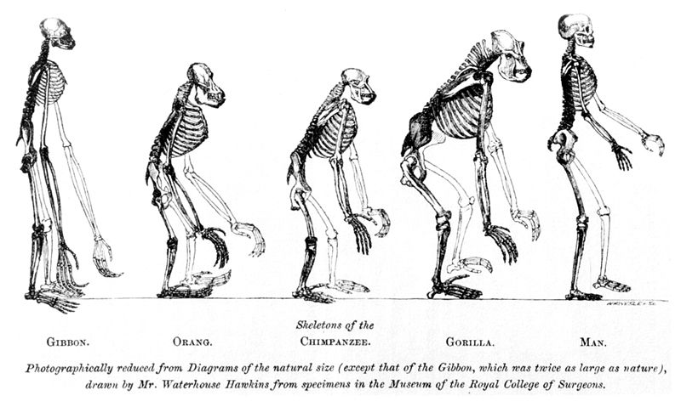
Human’s Place in Nature

Slide 4
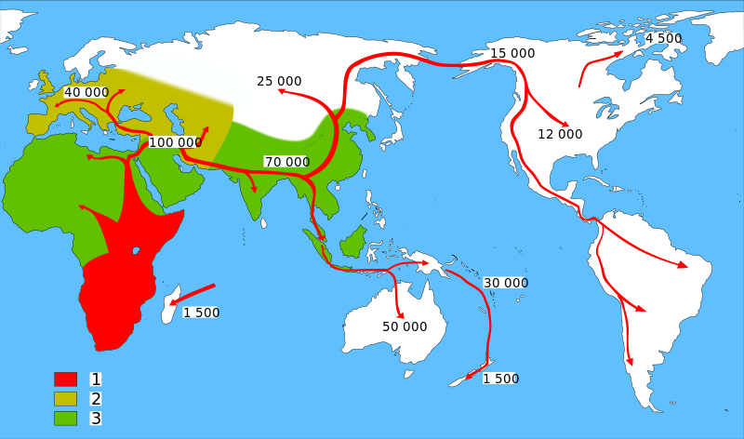
Map of early human Migrations “Out-of-Africa”
Homo sapiens (model humans)
Neanderthals (extinct human)
Early Hominids (early humans)
http://en.wikipedia.org/wiki/Recent_African_origin_of_modern_humans

Slide 5
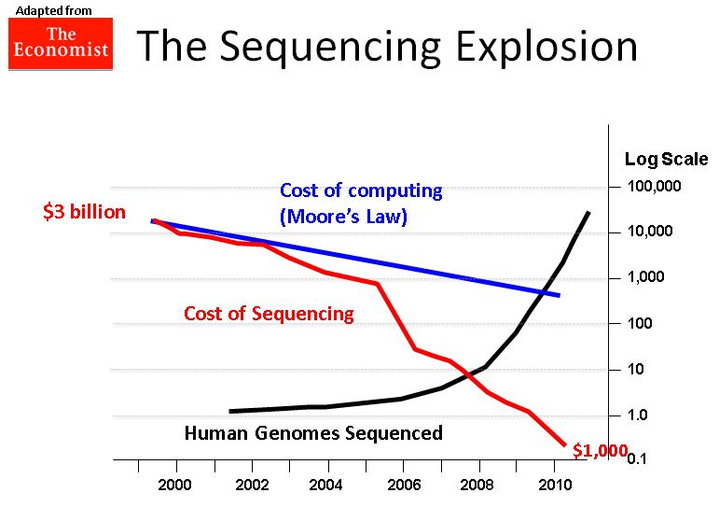
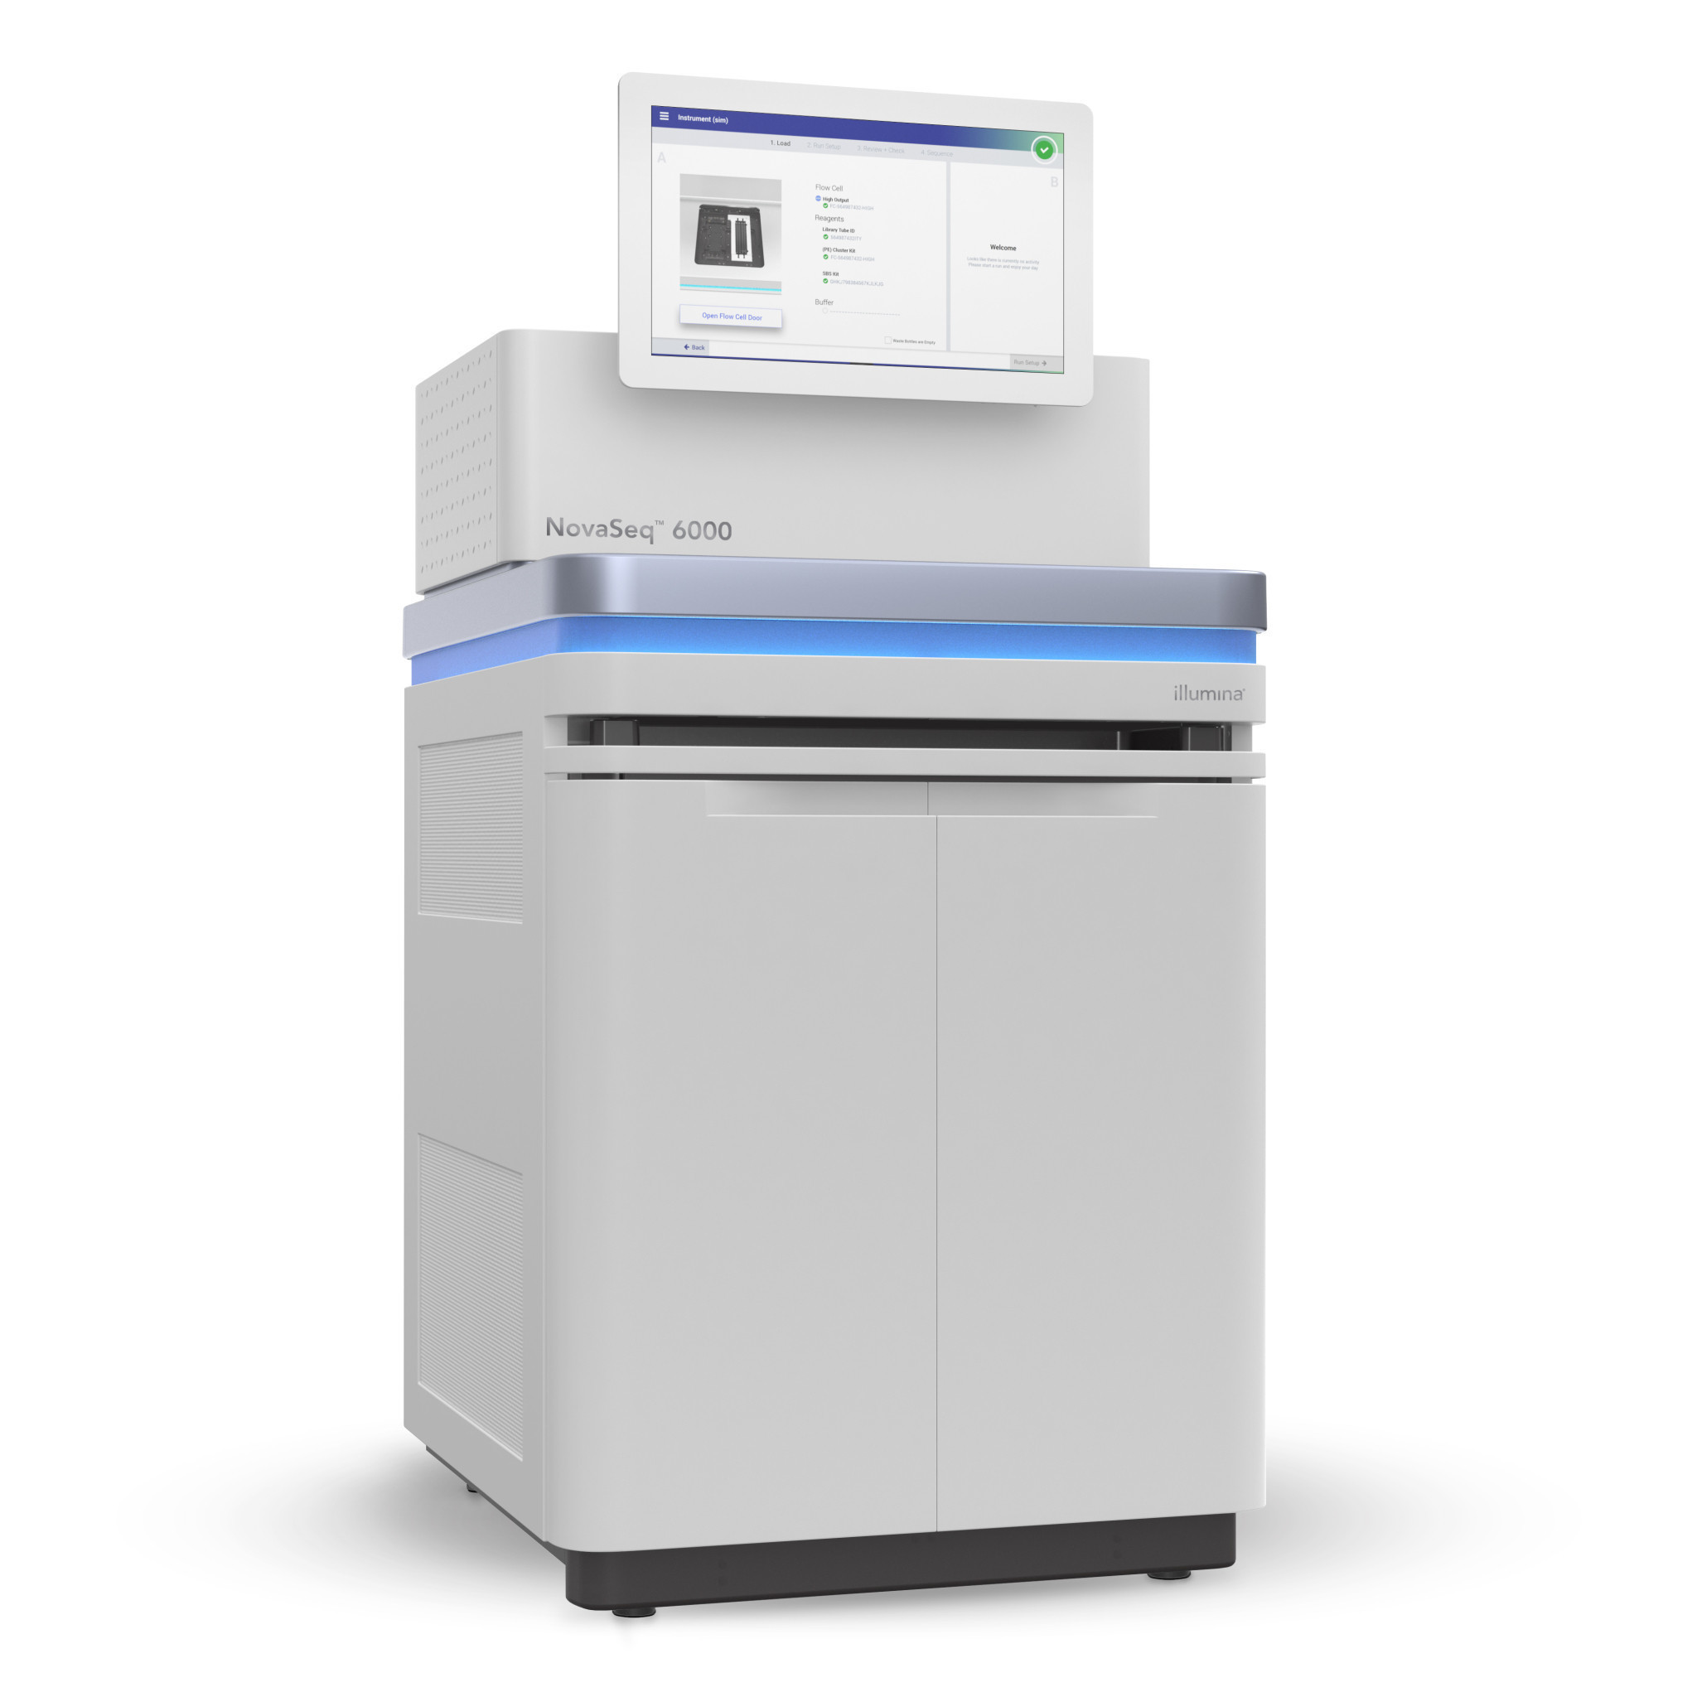
Now the bottleneck is computing/informatics
Processing this 3-billion-base-pair human genome takes immense computing power
1988
NIH &DOE
Human Genome Project
2017
Sanger sequencing:
$3 billion per human genome
~5 years
Illumina NovaSeq:
$100 per human genome
1 hour
Notes:
This departure from Moore’s law indicates that the transition between these technologies introduced a new cost-scaling regime.
https://www.genome.gov/12011239/
turning point 2005
Illuminar XTen $1000
$100
Bottleneck: informatics and analytics

Slide 6
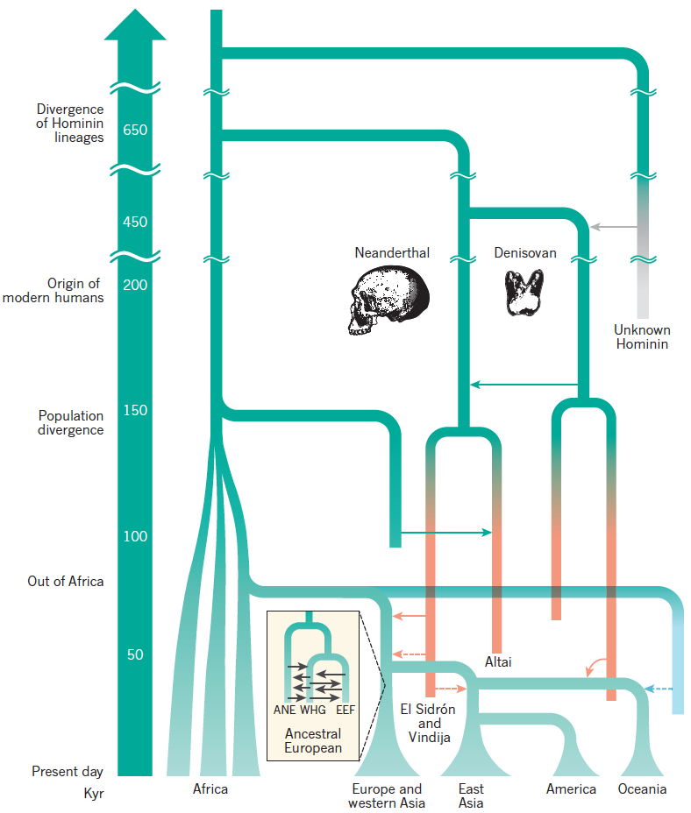
Simplified Model of Human Evolutionary History
Relationships btw contemporary populations and the approximate times at which they diverged are shown, including admixture events between groups of modern humans and between modern and archaic humans (well established in solid lines and tentative in dashed lines ).
Nielsen et al. Nature. 2017
Notes:
Potential small proportion of ancestry in Oceanic populations that is derived from an early out-of-Africa migration (turquoise).
Present day Europeans comprise admixture between three ancestral groups (ANE, ancient north Eurasian; EEF, early European farmer; WHG, west European hunter-gatherer).
East Asian people have about 20% more Neanderthal sequences compared to European people.
Potential small proportion of ancestry in Oceanic populations that is derived from an early out-of-Africa migration (turquoise).
Present day Europeans comprise admixture between three ancestral groups (ANE, ancient north Eurasian; EEF, early European farmer; WHG, west European hunter-gatherer).
East Asian people have about 20% more Neanderthal sequences compared to European people, which may reflect the effects of natural selection, the occurrence of further admixture events in the ancestors of present-day East Asians after the population split from Europeans or the dilution of Neanderthal ancestry in Europeans owing to admixture with populations that did not contain considerable levels of Neanderthal sequences.

Slide 7
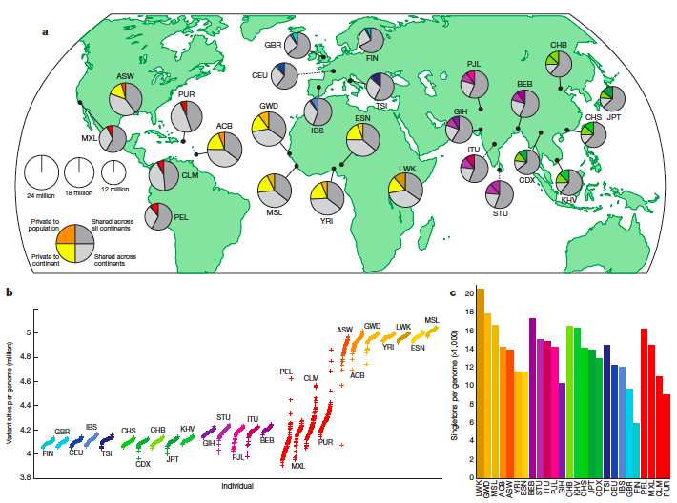
The 1000 Genomes Project
SNP-SNV expression quantitative loci mapping analysis:
We identified 54 eQTLs with a lead SV association (denoted SV-eQTL) and 10,100 eQTLs with a lead SNP association (10% FDR).
Although SNPs contribute more eQTLs overall, our results suggest SVs have a disproportionate impact on gene expression relative to their number.
Whole genome sequencing of 2504 individuals from 26 populations.
A typical genome differs from the reference human genome at 4.1 ~5.0 million sites (2,100 ~2,500 structural variants). 1000 Genomes Project Consortium. Nature 2010, 2011, 2012, 2015, 2016b.
Notes:
A – Total number of samples sequenced; B – Source of DNA (blood (bld) or LCL); C – Gender composition (Male/Female); D – Number that are part of mother-father-child trios (t), parent-child duos (d) or singletons (s).
What’s ACB, PEL, ITU, GIH, STU?

Slide 8
Clinical Sequencing – Federal Initiatives
International Cancer Genome Consortium (ICCG) and The Cancer Genome Atlas (TCGA) projects chart the genomic changes involved in more than 20 types of cancer (WGS of 5000 individuals, WES of 10,000 individuals).
Genomes England Project (the 100,000 Genomes Project) 2014, UK 10K Project. -> UK Biobank
Million Genome Project from Obama’s Precision Medicine Initiative, 2015. -> All of Us Project

Slide 9
Clinical Sequencing – Private Sections
J. Craig Venter plans to sequence one million genomes by 2020 using private funding.
One of the world’s largest private bio-banks, 23andMe, collected 800,000 spit samples.
Large disease consortia and hospitals/institutions/pharmaceutical/biotech companies conduct whole genome sequencing of clinical samples.
Notes:
Google Genomics
Facebook?

Slide 10
From Genomics to Metagenomics
Microbes thrive on us: we provide wonderfully rich and varied homes for our 100 trillion microbial (bacterial and archaeal) partners.
Human Microbiome Project
characterize microbial communities found at multiple human body sites and to look for correlations between changes in the microbiome and human health.
We are also host to countless viruses. A recent survey reported that human feces contain about a billion RNA viruses per gram, representing 42 viral “species”.
Viral Metagenomics
National Research Council (US) Committee on Metagenomics:
Challenges and Functional Applications. 2007

Slide 11
Outline
An overview of genomics and post-genomics era
Genetic privacy and security
Ethics and Regulations
Protection techniques

Slide 12
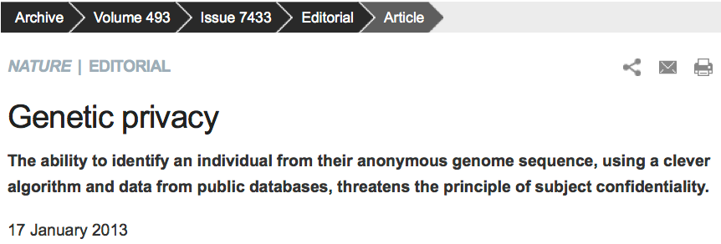
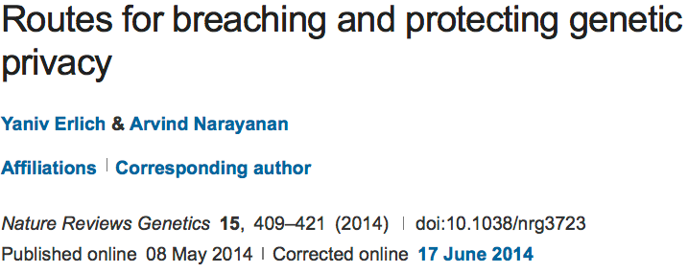
Genetic Privacy

Slide 13
Genetic Privacy Risks
Identity tracing attacks
e.g. identify a specific individual by their genetic sequence
Attribute disclosure attacks via DNA
e.g. identify a specific individual by their genetic sequence
Completion attacks
e.g. complete genetic information from partial data
Erlich Y and Narayanan A, "Routes for breaching and protecting genetic privacy." Nature Reviews Genetics 15.6 (2014): 409.

Slide 14
Identity Tracing Attacks
The goal of identity tracing attacks is to uniquely identify an anonymous DNA sample using quasi-identifiers – residual pieces of information that are embedded in the dataset.
Searching with meta-data
Identity tracing by genealogical triangulation
Identity tracing by phenotypic prediction
Identity tracing by side-channel leaks

Slide 15
Searching with Meta-data
Unrestricted demographic information conveys substantial power for identity tracing.
Health Insurance Portability and Accountability Act (HIPAA) Privacy rule
Pedigree structures contain rich information, especially when large kinships are available.
Another vulnerability of pedigrees is combining demographic quasi-identifiers across records to boost identity tracing despite HIPAA protections.

Slide 16
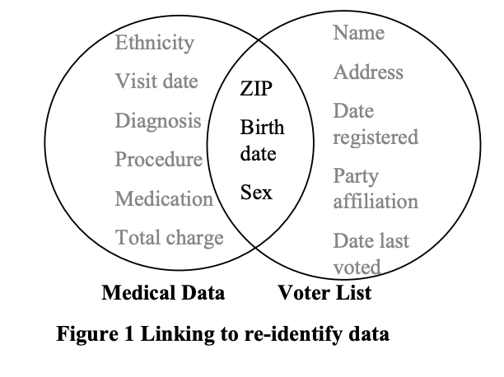
Searching with Meta-data
87% (216 million of 248 million) of the population in the United States had reported characteristics that likely made them unique based only on
{5-digit ZIP, gender, date of birth}.
99.98% of Americans would be correctly re-identified in any dataset using 15 demographic attributes.
L. Sweeney, Simple Demographics Often Identify People Uniquely. Carnegie Mellon University, Data Privacy Working Paper 3. Pittsburgh 2000.
Erlich Y and Narayanan A, "Routes for breaching and protecting genetic privacy." Nature Reviews Genetics 15.6 (2014): 409.

Slide 17
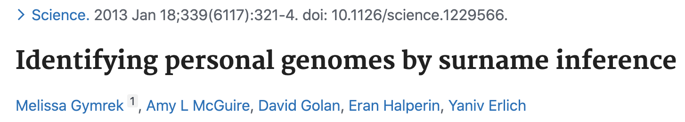
Identity Tracing by Genealogical Triangulation
Genetic genealogy attracts millions of individuals interested in their ancestry or in discovering distant relatives.
One potential route of identity tracing is surname inference from Y-chromosome data
The main limitation of surname inference is that haplotype matching relies on comparing Y chromosome Short Tandem Repeats (Y-STRs).
An open research question is the utility of non Y chromosome markers for genealogical triangulation.

Slide 18
Identity Tracing by Phenotypic Prediction
Predictions of visible phenotypes from genetic data could serve as quasi-identifiers for identity tracing.
Twin studies have estimated high heritabilities for various visible traits such as height and facial morphology.
Age prediction is possible from DNA specimens derived from blood samples.
But the applicability of these DNA-derived quasi-identifiers for identity tracing has yet to be demonstrated.

Slide 19
Identity Tracing by Side-channel Leaks
Side-channel attacks exploit quasi-identifiers that are unintentionally encoded in the database building blocks and structure rather than the actual data that is meant to be public.
The mechanism to generate database accession numbers can also leak personal information

Slide 20
Attribute Disclosure Attacks via DNA (ADAD)
ADAD attack: The adversary gains access to the DNA sample of the target. He or she uses the identified DNA to search genetic databases with sensitive attributes. A match between the identified DNA and the database links the person and the attribute.
The simplest scenario
The summary statistic scenario
The gene expression scenario

Slide 21
ADAD: the Simplest Scenario
The adversary can simply match the genotype data that is associated with the identity of the individual and the genotype data that is associated with the attribute.
Such an attack requires only a small number of autosomal single nucleotide polymorphisms (SNPs).
ADAD is a theoretical vulnerability of virtually any individual level DNA-derived omics dataset such as RNA-seq and personal proteomics.
Genome-wide association studies (GWAS) are highly vulnerable to ADAD.

Slide 22
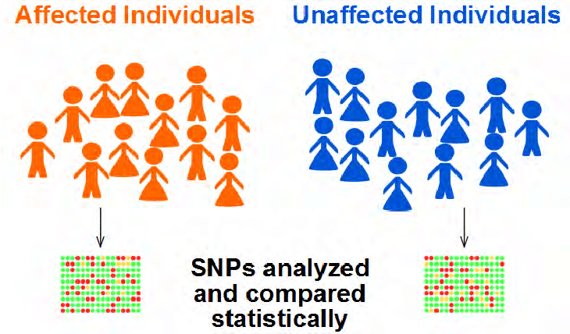
ADAD: the Summary Statistic Scenario
With the target genotypes in the case group, the allele frequencies will be positively biased towards the target genotypes compared to the allele frequencies of the general population.
The actual risk of ADAD has been the subject of intense debate.

Slide 23
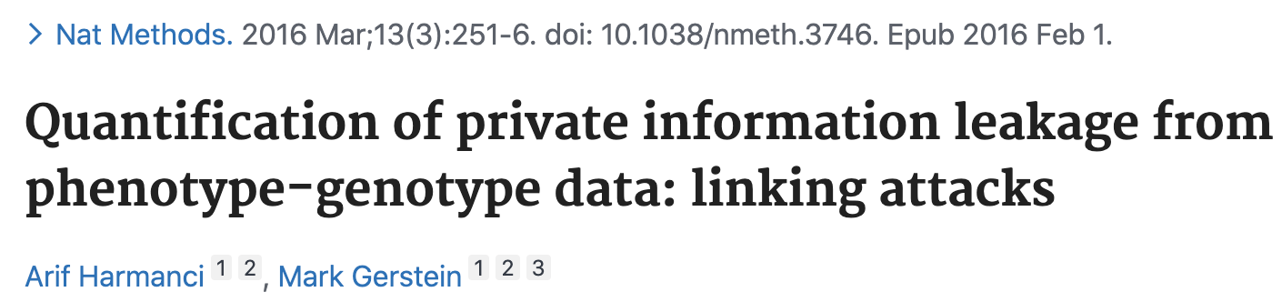
ADAD: the gene expression scenario
NIH’s Gene Expression Omnibus (GEO) publicly hold hundreds of thousands of gene expression profiles.
ADAD technique: The method starts with a training step that employs a standard expression quantitative trait loci (eQTL) analysis with a reference dataset. Next, the algorithm scans the public expression profiles. Last, the algorithm matches the target’s genotype with the inferred allelic distributions of each expression profile and tests the hypothesis that the match is random.
This ADAD technique has the potential for relatively high accuracy in ideal conditions.

Slide 24
Completion attacks
Genotype imputation: Jim Watson’s predisposition for Alzheimer’s disease from the ApoE locus despite masking of this gene
In the basic setting, the adversary obtains access to a single genetic dataset of a known individual. He then exploits this information to estimate genetic predispositions for relatives whose genetic information is inaccessible.
This attack is taking advantage of self-identified genetic datasets from OpenSNP.org

Slide 25
Completion attacks
Genotype imputation: Jim Watson’s predisposition for Alzheimer’s disease from the ApoE locus despite masking of this gene
In the basic setting, the adversary obtains access to a single genetic dataset of a known individual. He then exploits this information to estimate genetic predispositions for relatives whose genetic information is inaccessible.
In the advanced setting, the adversary has access to the genealogical and genetic information of multiple relatives of the target. The algorithm finds relatives of the target that donated their DNA to the reference panel and that reside on a unique genealogical path that includes the target.

Slide 26
Homer’s attack
Homer’s attack motivated the NIH to move the genotype and phenotype data from public domain to controlled access through dbGaP.
This paper demonstrated the ability to accurately and robustly determine whether individuals are in a complex genomic DNA mixture.
Homer N, Szelinger S, Redman M, et al. Resolving individuals contributing trace amounts of DNA to highly complex mixtures using high-density SNP genotyping microarrays. PLoS Genet. 2008;

Slide 27
Genomic Data
Privacy Breaches
Privacy Protection
Private/Controlled
Identity attack
Ethics/Regulations/Access Control
Trait attack
Completion attack
dbGaP
Genotypes, Statistics and Metadata
Ethics education
EBI
Wheeler 2008
Health Insurance Portability and Accountability Act (HIPAA) Breaches (1996)
Biobanks
Homer 2008
Hospitals
Wang 2009
Genealogy databases
Shringapyre 2015
Wang 2013, 2015, 2016
Differential Privacy
Commercial genetic databases
Nyholt 2009
GWAS logistic regression
Public
Humbert 2015, 2017
Ney 2019
Advanced statistical models
HapMap
1000GP
Ayoz 2021
Cryptography
HGDP
Goodrich 2009
SGDP
Gymrek 2013
Homographic encryption
Erlich 2018
openSNP
Secure multiparty computation
Edge 2019
HGP
GWAS catalog
RNA and Statistics
Harmanci 2016
Shi X and Wu X. "An overview of human genetic privacy." Annals of the New York Academy of Sciences 1387.1 (2017): 61-72.
Notes:
99.98% of Americans would be correctly re-identified in any dataset using 15 demographic attributes.

Slide 28
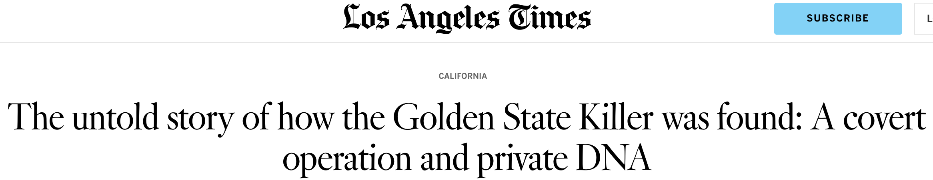
The Golden State Cold Case
The DNA profile of the Golden State Killer was uploaded to GEDmatch, an open-source platform frequently used by members of the public to trace their heritage.
The test result was first sent to FamilyTreeDNA, which created a DNA profile and allowed law enforcement to set up a fake account to search for matching customers.
When that produced only distant leads, a civilian geneticist working with investigators uploaded the forensic profile to MyHeritage.
It was the MyHeritage search that identified the close relative who helped break the case.

Slide 29
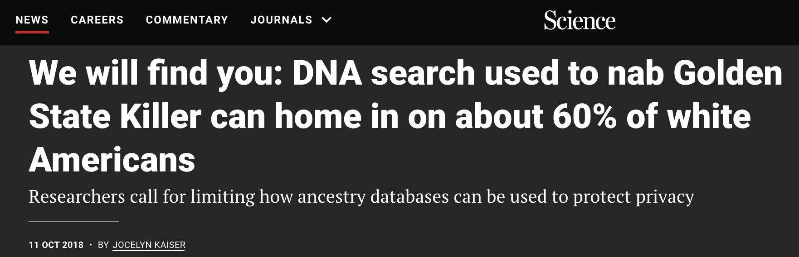
Ethics and Privacy

Slide 30
Outline
An overview of genomics and post-genomics era
Genetic privacy and security
Ethics, Regulations and Laws
Protection techniques

Slide 31
Ethics of genetic privacy and current regulations
Standards for Privacy of Individually Identifiable Health Information in the Health Insurance Portability and Accountability Act of 1996 (HIPAA).
The Privacy Rule was established to address the use and disclosure of individuals’ health information by covered entities, and provides standards for individual privacy rights to understand and control the use of their health information.
Many large human genome projects provide ethics education

Slide 32
Ethics and HIPAA Review
Key to advancing genetics diagnosis research
Private personal health information can be protected
Discrimination/Bias based on released heath information can be eliminated (minimized)
HIPAA Privacy Rule: All federal grants with human subjects involved should be protected by HIPAA
https://www.hhs.gov/hipaa/index.html

Slide 33
Introduction to HIPAA
The Standards for Privacy of Individually Identifiable Health Information (“Privacy Rule”) establishes, for the first time, a set of national standards for the protection of certain health information.
The U.S. Department of Health and Human Services (“HHS”) issued the Privacy Rule to implement the requirement of the Health Insurance Portability and Accountability Act of 1996 (“HIPAA”).
The Privacy Rule standards address the use and disclosure of individuals’ health information—called “protected health information” by organizations subject to the Privacy Rule — called “covered entities,” as well as standards for individuals' privacy rights to understand and control how their health information is used.
Within HHS, the Office for Civil Rights (“OCR”) has responsibility for implementing and enforcing the Privacy Rule with respect to voluntary compliance activities and civil money penalties.

Slide 34
Information Protected by HIPAA
Protected Health Information
The Privacy Rule protects all “individually identifiable health information”
Only covers patient information kept by “covered entities”, i.e., health providers, insurers and data clearinghouses, as well as their business partners
De-Identified Health Information
There are no restrictions on the use or disclosure of de-identified health information.

Slide 35
Information NOT Protected by HIPPA
De-identified health information
Medical information not originated from entities not covered by HIPAA (e.g. 23andMe, genetic screening companies)
Consumer-generated health information (home paternity tests, fitness trackers, health apps, social media)
Personal information (ethic, identity, etc.) inferred from de-identified health information
Meta data such as age, geographical regions, races of participants

Slide 36
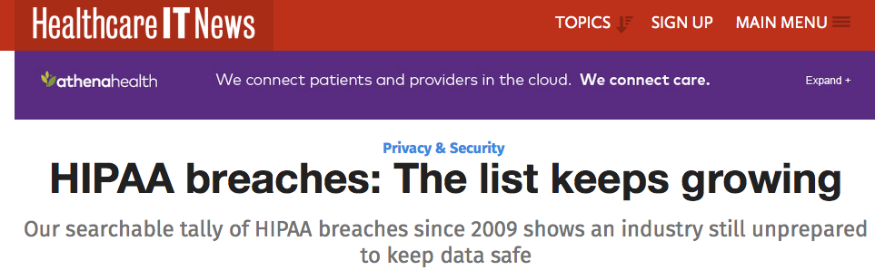
HIPAA Breaches
More than 41 million people have had their protected health information compromised in HIPAA privacy and security breaches.
https://www.hhs.gov/hipaa/index.html

Slide 37
NIH Policy and Ethics Issues
Coverage and Reimbursement of Genetic Tests
Genetic Discrimination
Informed Consent for Genomic Research
Intellectual Property
Privacy in Genomics
Regulation of Genetic Tests
https://www.genome.gov/27527631/policy--ethics-issues/

Slide 38
Coverage and Reimbursement of Genetic Tests
Genomic medicine has the capacity to revolutionize clinical practice.
One challenge insurers face is the difficulty of deciding when to reimburse for genetic tests that health care providers have offered their patients.
Payers are having trouble keeping up with the volume of new genetic and next-generation sequencing tests that are coming onto the market.
https://www.genome.gov/19016729/coverage-and-reimbursement-of-genetic-tests/

Slide 39
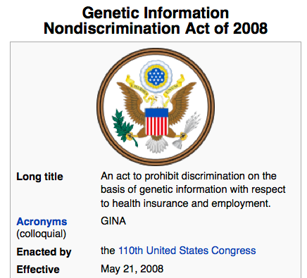
HIPAA Safe Harbor Rule
Dissemination of demographic identifiers has been the subject of tight regulation in the US health care system.
The maximal resolution of any date field, such as hospital admission dates, is in years.
The maximal resolution of a geographical subdivision is the first three digits of a zip code (for zip code areas with populations of >20,000).
http://www.ginahelp.org/GINAhelp.pdf

Slide 40
Genetic Discrimination
Many Americans fear that participating in research or undergoing genetic testing will lead to being discriminated against based on their genetics.
The Genetic Information Nondiscrimination Act (GINA) was passed into law, prohibiting discrimination by employers and health insurers.
There are also other legal protections against genetic discrimination by employers, health insurers, and others.

Slide 41
Informed Consent for Genomic Research
Advances in genomic technology and analytical tools are enabling discoveries that enhance our understanding of the impact of genomic variants on health and disease.
Informed consent shows respect for personal autonomy and is an important ethical requirement in research. (HIPAA Privacy Rule)
Informed consent involves two fundamental components: a dialogue or process, and a form.
https://www.genome.gov/27026588/informed-consent-for-genomics-research/

Slide 42
Intellectual Property
In a landmark decision in June 2013, the Supreme Court determined that DNA in its natural form cannot be patented.
The National Human Genome Research Institute (NHGRI) to research "legal issues regarding patents" as part of the then center's research into the ethical, social, and legal implications of human genome research.
The Courts and Gene Patents
https://www.genome.gov/19016590/intellectual-property/

Slide 43
Privacy in Genomics
Each person's DNA sequence includes health and other information about them and their families.
Usage and privacy need to be balanced.
Genetic Information Nondiscrimination Act (GINA)
The HIPAA Privacy Rule
Certificates of Confidentiality
The Freedom of Information Act (FOIA)
NIH Genomic Data Sharing Policy
https://www.genome.gov/27561246/privacy-in-genomics/

Slide 44
Outline
An overview of genomics and post-genomics era
Genetic privacy and security
Ethics and Regulations
Protection techniques

Slide 45
Techniques for Privacy Protection
Access control
Differential privacy (DP)
Cryptographic solution
Homomorphic encryption (HE)
Secure multiparty computation (MPC)

Slide 46

Access Control
Allows users to download data only after approval (e.g. dbGaP)
A trust-but-verify approach: where users cannot download the data without restriction but may execute certain types of queries, which are recorded and audited by the system
Allowing the original participants to grant access to their data instead of delegating this responsibility to a data access committee.

Slide 47
Differential Privacy (DP)
Differential privacy is a system for publicly sharing information about a dataset by describing the patterns of groups within the dataset while withholding information about individuals in the dataset.
Database
Histogram
New individual’s phenotype

Slide 48
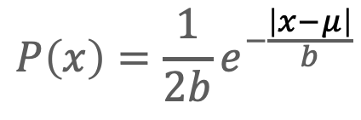
Differential Guarantee
+ noise
noise ~ Laplacian distribution
$$P\left(x\right)=\frac{1}{2b}e^{−\frac{\left|x−μ\right|}{b}}$$
Dwork C, and Aaron R. “The algorithmic foundations of differential privacy.” Foundations and Trends in Theoretical Computer Science 9.3–4 (2014): 211-407.
Task C. “Privacy-preserving social network analysis”, Purdue University.

Slide 49
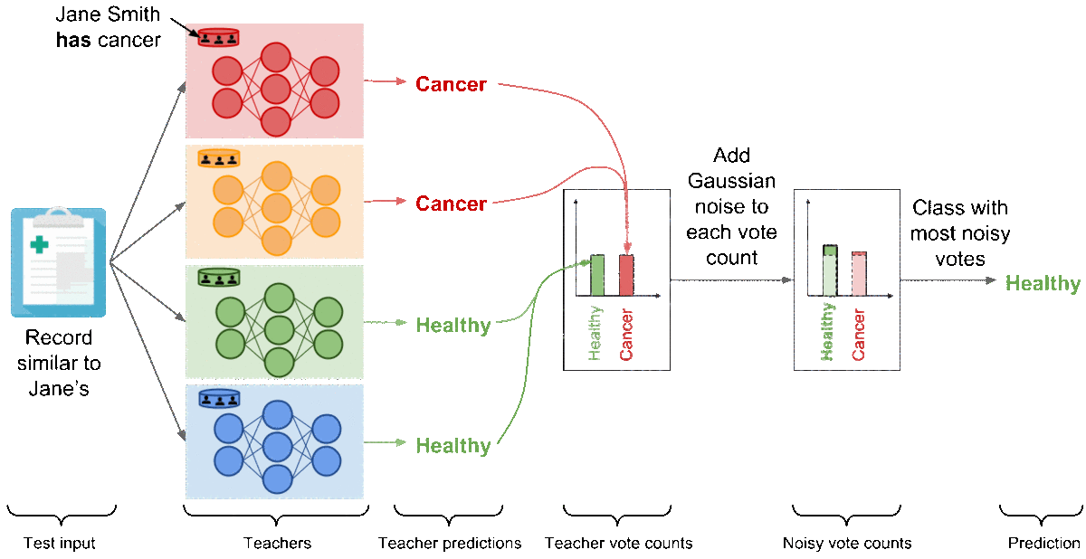
Differential Privacy in Machine Learning
DP
DP
DP
DP

Slide 50
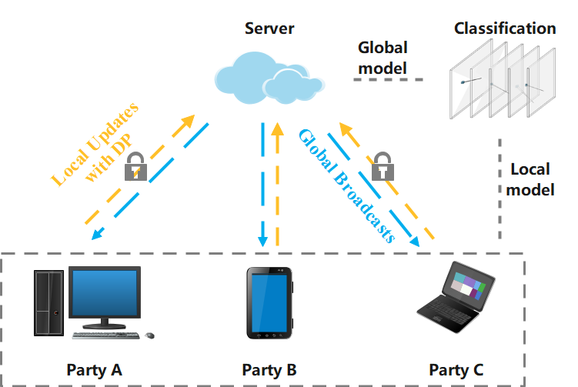
Federated Learning (FL)
An Illustration of Federated Learning (FL). This FL framework includes a central trusted server and three collaborating parties (A,B,C) that can be deployed on different computing devices.

Slide 51
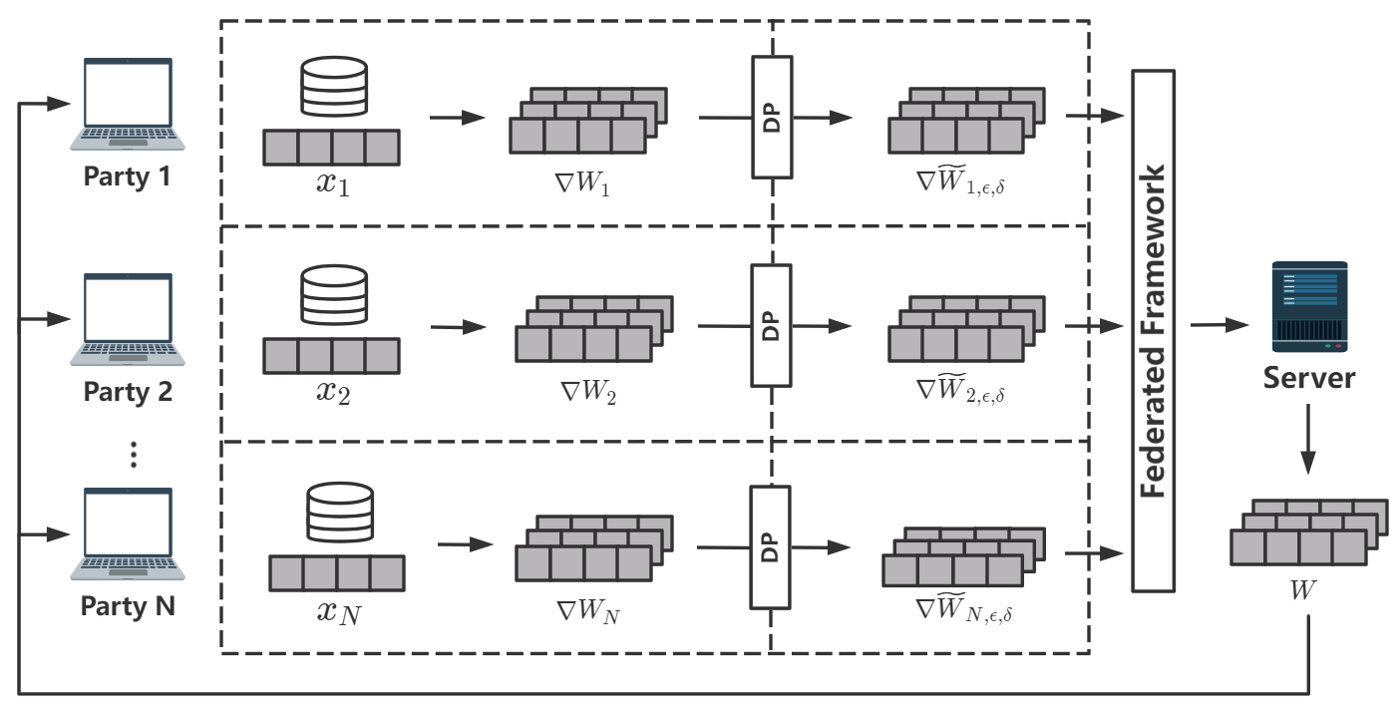
FedDP: Differentially Private FL for Disease Prediction
An Overall Framework of FedDP. Local data 𝑥_{𝑖} distributed at each party is independent from each other. First, local gradients ∇𝑊_{𝑖} are generated in parallel by each local optimizer deployed at each party and trained on each local dataset. Then, the server gathers all gradients ∇ ̃𝑊_{𝑖,𝜖,𝛿} from multiple parties after (𝜖,𝛿) DP was applied to original gradients ∇𝑊_{𝑖}. Finally, global weights are computed and broadcast to each party at the end of each round by aggregating all ̃𝑊_{𝑖,𝜖,𝛿}.
Li B, Gao H, and Shi X. “FedDP: Secure Federated Learning for Disease Prediction with Imbalanced Genetic Data”.

Slide 52
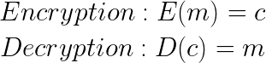
Homomorphic Encryption (HE)
Homomorphic encryption is a form of encryption that allows computations to be carried out on ciphertext, thus generating an encrypted result which, when decrypted, matches the result of operations performed on the plaintext.
f (x @ y) = f(x) @ f(y)
where @ can be any operator.
Let’s define out notation for message, ciphertext, encryption, and decryption:
Assuming homomorphism, we then get:

Slide 53
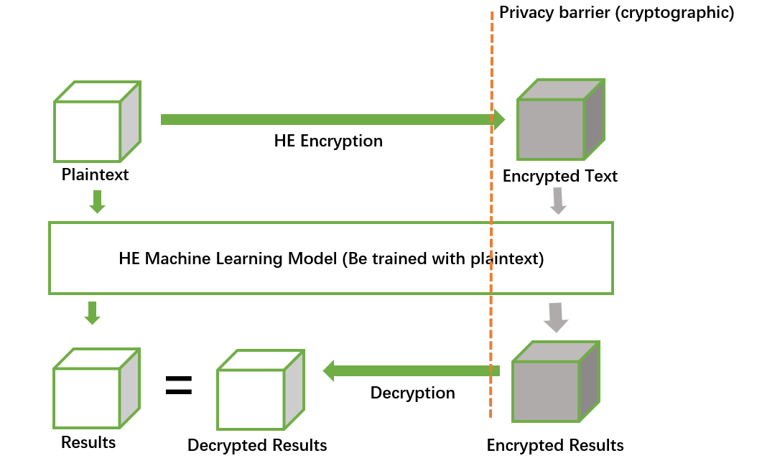
Secure and Privacy-preserving ML via HE
1.Machine Learning models will be trained using plaintext.
2.The trained plain models can be used on homomorphically encrypted data, so that it can be hosted on untrusted servers.
3.After decrypting, the results are same as results of non-encrypted data

Slide 54
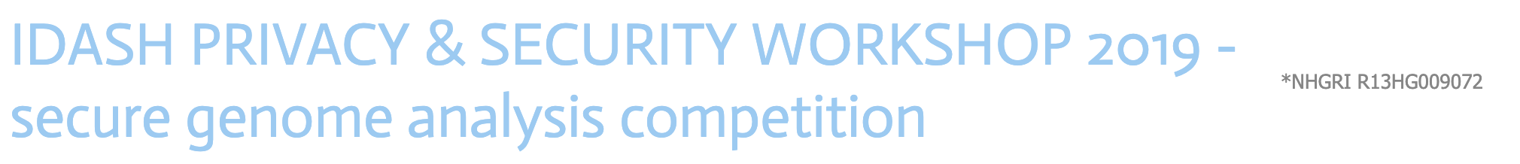
iDASH 2019: HE-Imputation

Slide 55
Secure Multiparty Computation (SMC)
Yao’s millionaires’ Problem
Solution:
The trusted third person
Alice
Bob
This problem discusses two millionaires, Alice and Bob, who are interested in knowing which of them is richer without revealing their actual wealth.
A.C. Yao, Protocols for secure computations, in: Foundations of Computer Science, 1982, Sfcs’08. 23rd Annual Symposium on, IEEE, 1982: pp. 160–164.

Slide 56
Secure Multiparty Computation (SMC)
Private auction
Many parties wish to execute a private auction
The highest bid wins
Only the highest bid (and bidder) is revealed
Solution:
a trusted auctioneer

Slide 57
Secure Multiparty Computation
Secure multiparty computation allows us to perform analysis on private data without compromising it.
Parties 𝑃₁, …, 𝑃_{𝑛}
Party 𝑃_{𝑖} has private input 𝑥_{𝑖}
The parties wish to jointly compute a (known/unknown) function 𝑦 = 𝑓(𝑥₁, …, 𝑥_{𝑛})
The computation must preserve certain security properties, even if some of the parties collude and maliciously attack the protocol.

Slide 58
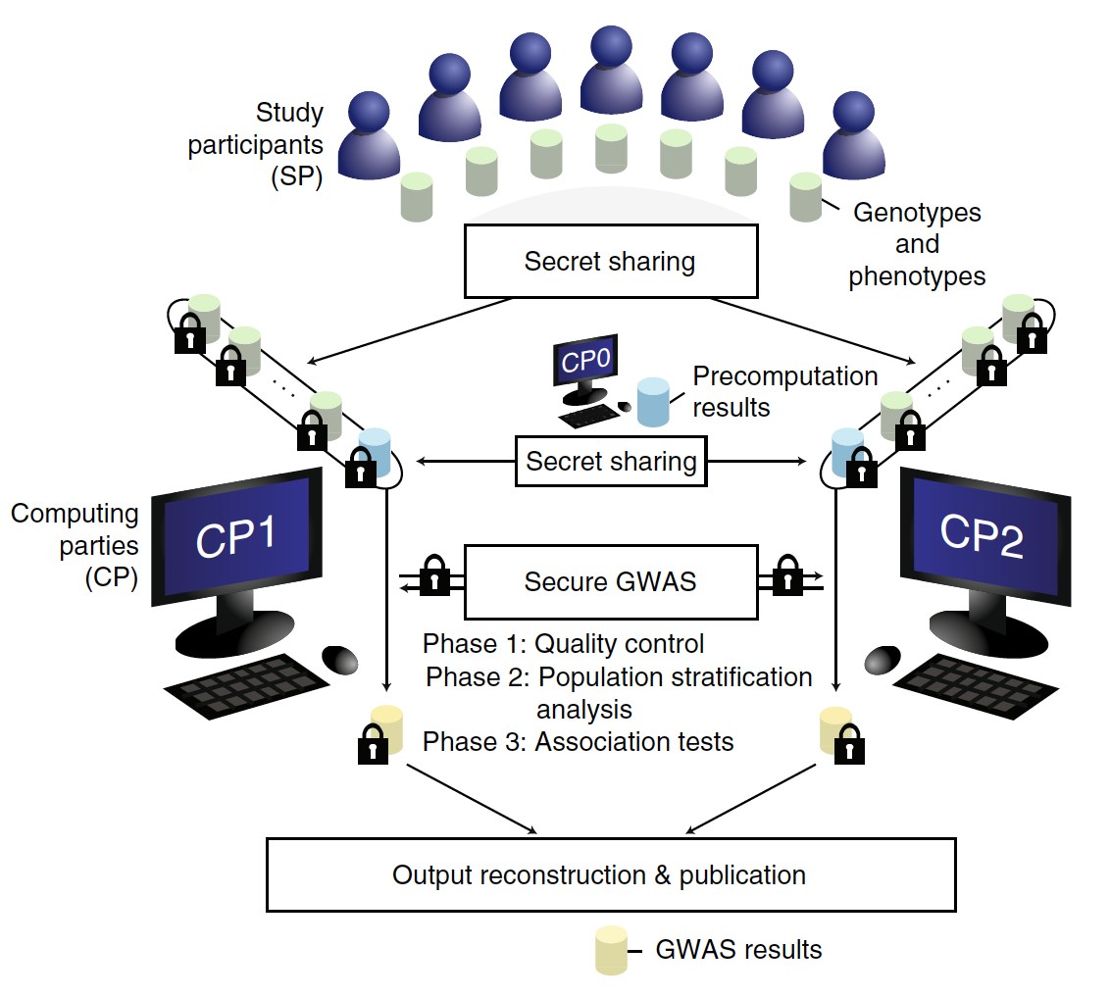
Secure GWAS Using SMC
Study participants (private individuals or institutes) secretly share their genotypes and phenotypes with computing parties (research groups or government agencies), denoted CP1 and CP2.
CP1 and CP2 jointly carry out the secure genome-wide association study (GWAS) protocol to obtain association statistics without revealing the underlying data to any party involved.
An auxiliary computing party (CP0) performs input-independent precomputation to greatly speed up the main computation
Cho H, Wu DJ, Berger B, "Secure genome-wide association analysis using multiparty computation." Nature Biotechnol. 2018 Jul;36(6):547-551.

Slide 59
Summary of Protection Techniques
A hybrid system may need to integrate multiple techniques
Tradeoff between utility and privacy/security
These methods are computationally intensive, and hard to scale up to large datasets
Confidential Computing with Trusted Executive Environment (e.g. Intel's SGX)

Slide 60
Conclusion
Security and privacy of genomic data is a growing concern
Existing regulations and techniques are not sufficient for protecting genetic privacy
New regulations, guidelines, and techniques are to be developed to realize the full potential of genomic medicine
Research and education from multiple disciplinaries is in great need to advance precision health and open science

